Slide 1
They're all coming to get you
Math Club 5/9/2011
(how mathematicians fool you with their deceptive proofs)

Slide 2
The math game
I will present a completely incorrect proof
You have to pinpoint the error in the proof

Slide 3
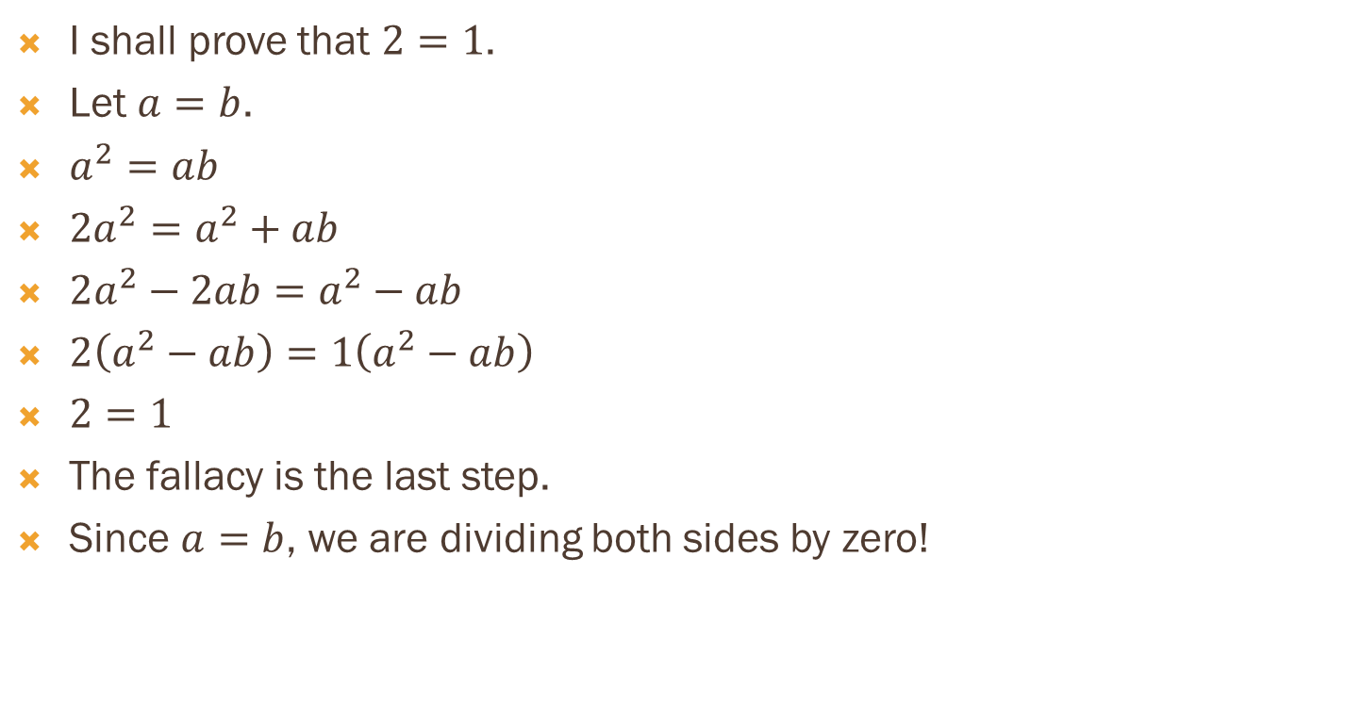
Example
I shall prove that $2=1$.
Let $a=b$.
$a^{2}=ab$
${2a}^{2}=a^{2}+ab$
$2a^{2}−2ab=a^{2}−ab$
$2\left(a^{2}−ab\right)=1\left(a^{2}−ab\right)$
$2=1$
The fallacy is the last step.
Since $a=b$, we are dividing both sides by zero!

Slide 4
Round 1
I shall prove that $1=0$.
Take the statement $x=1$.
Take the derivative of both sides: $\frac{d}{dx}x=\frac{d}{dx}1$
Then $1=0$.
What went wrong?

Slide 5
Round 2
I shall prove that $1+2+4+8+16+…=−1$.
Let $x=1+2+4+8+…$.
Then $2x=2+4+8+16+…$.
$2x−x=−1$
$1+2+4+8+…=−1$
What went wrong?

Slide 6
Round 3
I shall prove by induction that in any group of $n$ people, either they are all boys, or they are all girls.
This is obviously true for $n=1$.
Let $G$ be any group of $n+1$ people. We prove that any two people $x$ and $y$ in $G$ are of the same sex.
Consider everyone except $x$. All of them are the same sex.
Also consider everyone except $y$. All of them are the same sex
Take any member $z$, who has the same sex as $x$ and $y$.
Therefore any $x$ and $y$ in the group have the same sex.
The theorem is proved. What went wrong?

Slide 7
Round 4
I shall prove that $0=1$.
Begin by evaluating $\int{\frac{1}{x}dx}$ by parts.
Let $u=\frac{1}{x}$ and $dv=dx$.
Then $du=−\frac{1}{x^{2}}dx$ and $v=x$.
Hence $\int{\frac{1}{x}dx}=\frac{x}{x}−\int{−\frac{x}{x^{2}}dx}=1+\int{\frac{1}{x}dx}$.
Therefore $0=1$. What went wrong?

Slide 8
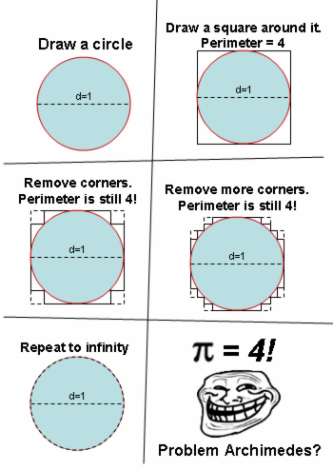
Round 5

Slide 9
Round 6
I can destroy the universe with a pencil!
Assume that there is no friction, pencil is uniform, etc, etc.
Put the pencil up to a wall and pull one end away with constant velocity while the other end slides down the wall.
As your end of the pencil is distance $x$ from the wall, the other end is distance $y=\sqrt{L^{2}−x^{2}}$ where $L$ is the length of the pencil.
Differentiating with respect to time, $\frac{dy}{dt}=−\frac{x\frac{dx}{dt}}{\sqrt{L^{2}−x^{2}}}$
But $\frac{dx}{dt}=v$ so $\frac{dy}{dt}=−\frac{xv}{\sqrt{L^{2}−x^{2}}}$
So $\frac{dy}{dt}$ approaches $−∞$ as $x→L$. The pencil crashes on the ground at infinite speed and infinite force!

